Slide 1
Data science Internship
Data Science on Subscription service (Final Project)
By: Adeniyi Funmilayo Zion
Team Achievers 2023

Slide 2
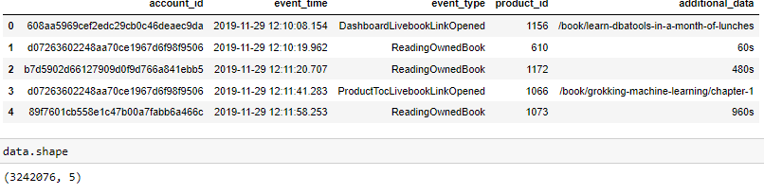
Summary of Features of subscription service Data

Slide 3
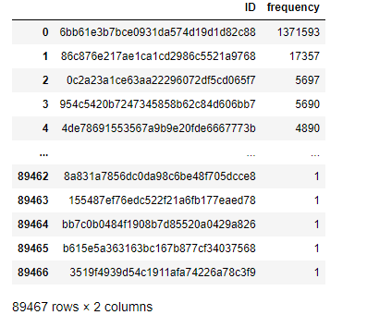
Data Preparation and Analysis
The data has 3242076 rows and 5 columns.
The column for additional data has missing values/data. the entire column was deleted since it has less effect on the analysis
For each column a new table is formed which has frequency for unique categories

Slide 4
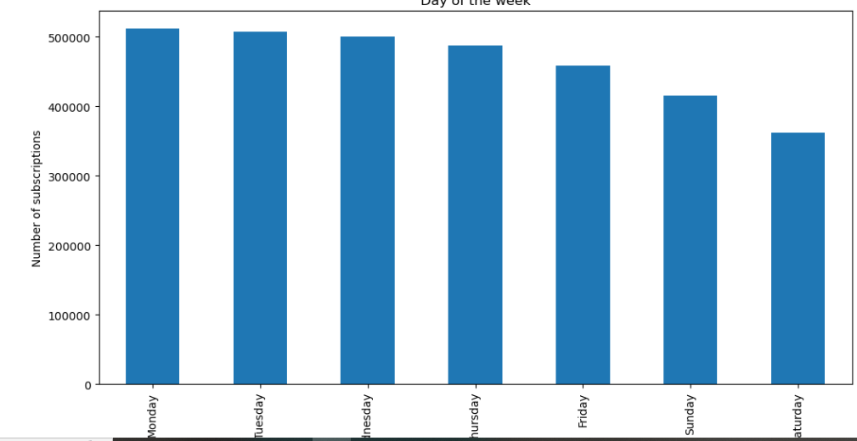
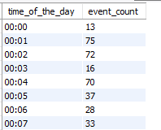
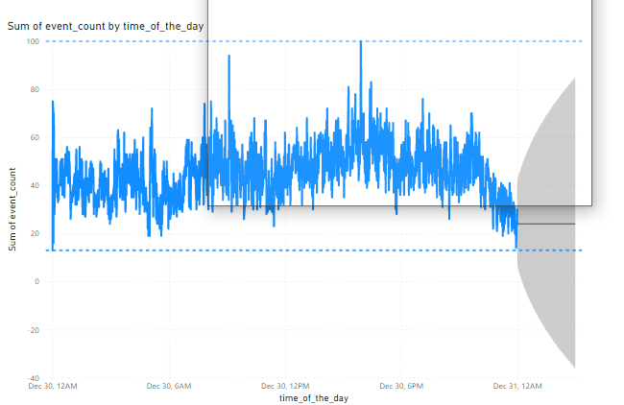
Forecast for The next 24hrs using event_time

Slide 5
Summary of Analysis on Subscription service
Account with the most common id. 'caffe2b03e6057845c52212acaaa1a34’ (1574)
Account with the list event 'eb19e0af88f04dd5cd33bc7ae13cb85f’ (1)
The list event (event_type) ’
The highest Event
'ReadingOwnedBook’ (246)

